Slide 1
British Airways
Model Training And Predictions
28/11/2022

Slide 2
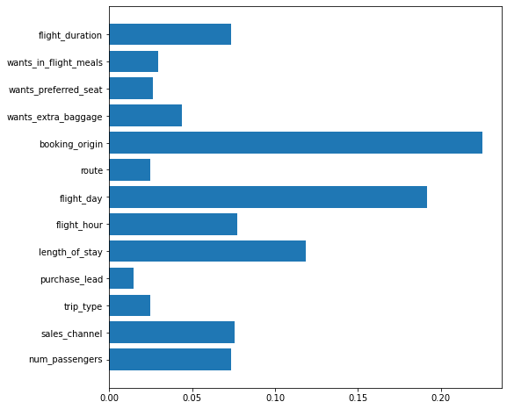
Model Prediction and Accuracy
As you can see from bar chart the most important features in predictions are:
flight_duration
booking_origin
flight_day
flight_hour
length_of_stay
sales_channel
num_passengers
We used XGBoost Classifier and the accuracy is 84.97%.

